Slide 1


UNIVERSITY OF BASRA
COLLEGE OF MEDICINE
DEPARTMENT OF PATHOLOGY AND FORENSIC Medicine
Blood transfusion
Dr. Ala’a A.Razak Abood
Iraqi Board of Haematopathology

Slide 2
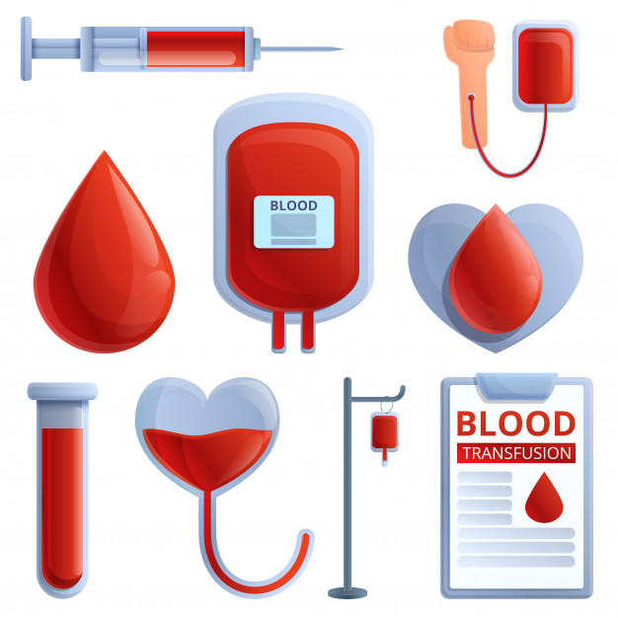

Slide 3
Definition :
the safe transfer of blood and its components from a donor to a recipient.

Slide 4
Blood components :

Slide 5
Plasma depleted- red cells
platelets
Fresh frozen plasma

Slide 6
Red cell antigenes:
A antigen
B antigen

Slide 7
Blood group antibodies:
1- Naturally occurring antibodies
2- Immune antibodies

Slide 9
ABO system:

Slide 10
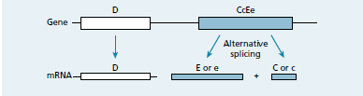
Rh system:

Slide 11
Cross match and pre transfusion testing:

Slide 12
Thank
You

